Slide 1

Loan Option Evaluation
Data Team:
Andrew Griffith
Christopher Russel
Joseph Seay
Sara Shockley

Slide 2
Overview
Objective and Data
Findings
Results & Recommendations

Slide 3
Objective and Data Predicting Loan Interest Rates Using Borrower and Loan Characteristics
Understand what factors drive the interest rate so borrowers can make informed decisions
Data
Target: Interest Rate
Features Analyzed:
FICO score (credit risk)
Loan length
Amount requested
Amount funded
Approach
Statistical models
Linear Regression
Use coefficients to quantify relationships
Decision Tree Regressor
Use Feature Importance to evaluate rate drivers

Slide 4
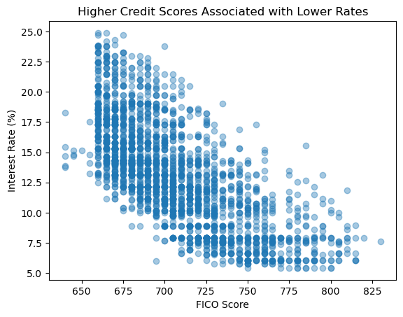
Findings
Initial analysis indicated credit score is a major driver
Decision Tree Analysis
Feature | Importance
Amount Requested | 8.86%
FICO Score | 69.04%
Loan Length | 22.10%
Notes:
FICO contributed to 69% of the model’s ability to explain differences in interest rate

Slide 5
Results and recommendations
Linear Regression Analysis
Model Result | Interest Rate Impact | Recommendation
FICO: -0.088 | +50 points ~ 4.4% lower | Vigorously improve credit score prior to applying
Loan Length: +0.139 | 36 → 60 months ~ 3.3% higher | Evaluate shorter repayment terms
Loan Amount: +0.0001 | + $10,000 ~ 1.4% higher | Borrow based on smallest actual need
Borrowers have the greatest opportunity to improve loan terms by strengthening credit factors and carefully selecting loan structure before applying.
Loan Interest Rate Predictor

Slide 6
Summary
Objective and Data
Findings
Results & Recommendations
Questions?

